Slide 1
Cool Term Use with Arduino
Only one program can use the serial port at any time.
Stopping the Serial Monitor in Arduino is usually enough to allow CoolTerm to use the port.
Also, disconnect from CoolTerm to use the Arduino IDE again.
Start Cool Term
Options:Serial Port:Port and choose the Arduino hardware port and the baud rate. The baud rate is set in the Arduino sketch.
Connection:Capture to Textfile:Start and choose where to put the file that will contain data from the Arduino. Let it run to get the data. Data will flow after the next step.
Click on Connect.
After you have the data, stop data acquisition so the new file can be created. Otherwise it will continue to capture data.
Connection:Capture to Textfile:Stop
See the following slides for step-by-step instructions. Note that Cool Term versions may be different, but the ideas remain the same.
By Pat Arnott

Slide 2
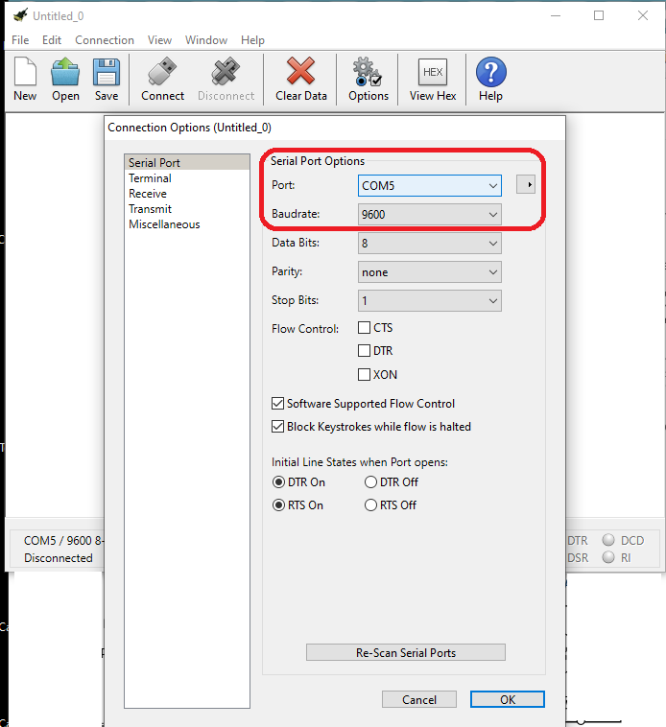
Choose Port and Baudrate

Slide 3
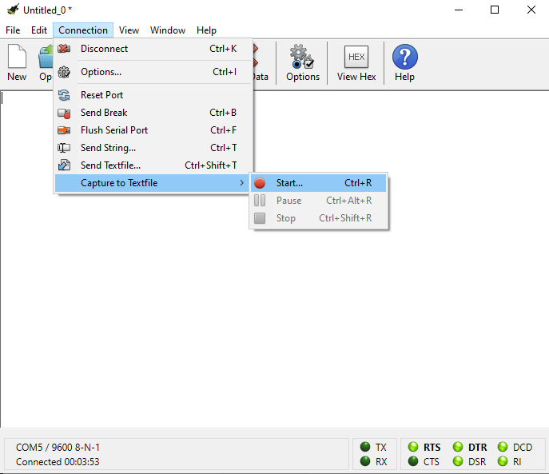
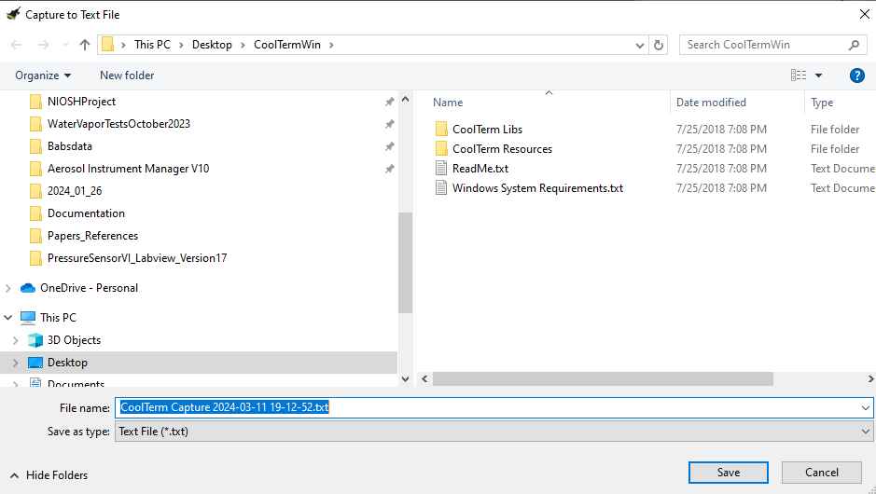
Connection:Capture to Textfile:Start and choose where to put the file that will contain data from the Arduino. Let it run to get data.

Slide 4
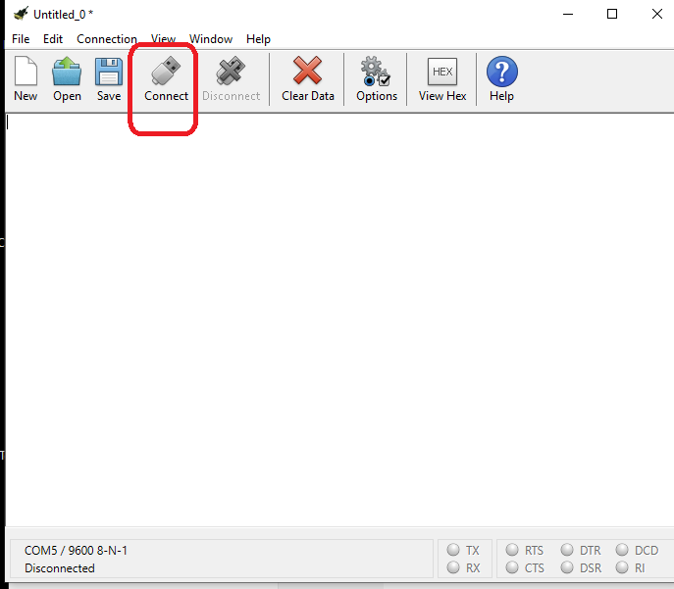
Connect

Slide 5
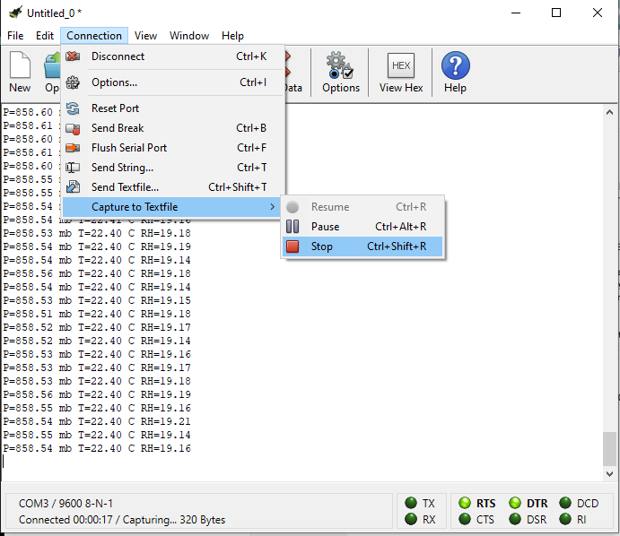
After you have the data, stop data acquisition so the new file can be created. Otherwise it will continue to capture data.
Connection:Capture to Textfile:Stop

